Slide 1

Work System Design Project
IM29202
Sanskar Agrawal 20IM30019
Sneha Kumari 20IM30020
Sridhara Manideep 20IM30021
Suvigya Saxena 20IM30022
Vedant Tarole 20IM30023
Trisha Sarwade 20IM30024
Udit Jain 20IM30025
Sanil Upasani 20IM30026
-By Group 4

Slide 2

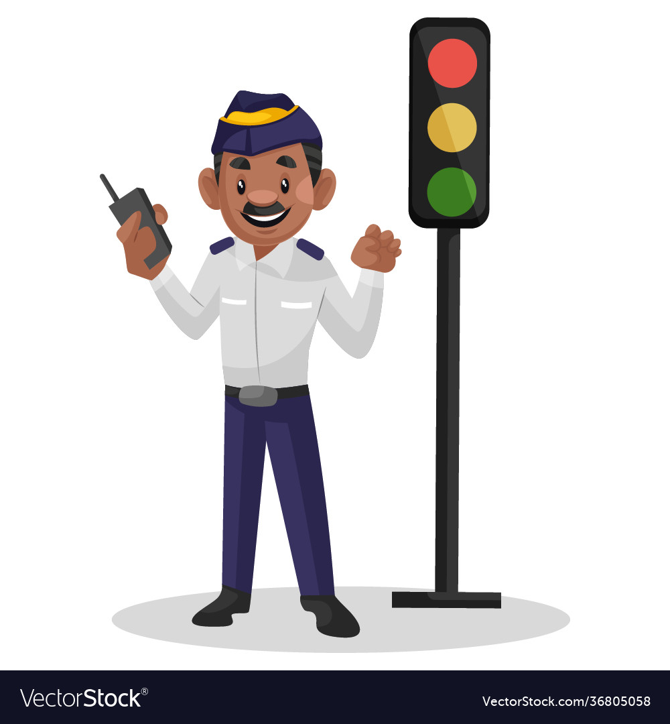
Defense and Security
Traffic Police Work System

Slide 3


Our Problem Statement
When we go around in city and we see Traffic Policemen stand in extreme weather conditions like hot sun, rain, etc and get exposed to air and noise pollution.
Also, especially during peak hours, when people don't follow rules policemen have a lot of vehicles and noise to handle, and thus causing mental stress and fatigue.

Slide 4
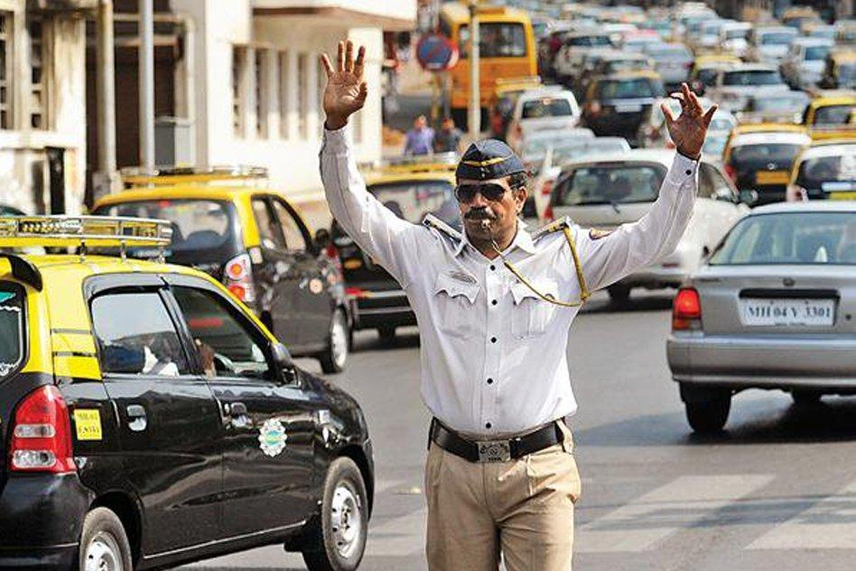
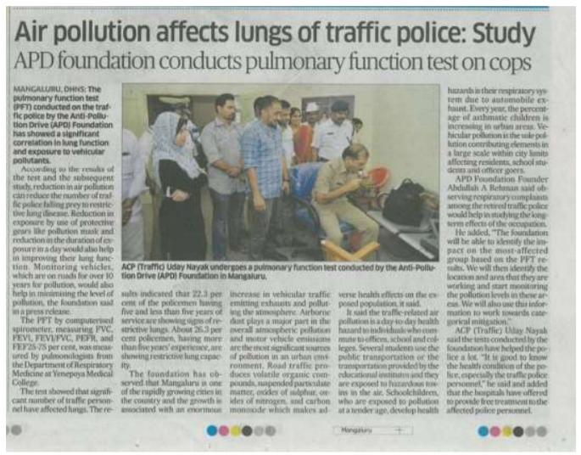
Hence, we thought of some Work System Design that can improve and ease his life, and keep a check on people who don't follow rules.

Slide 5
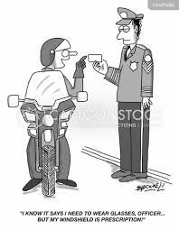
Drawbacks of current Work System
Traffic Policemen get exposed to extreme weather conditions and pollution. Recent studies have shown that the L_{eq} average during peak traffic load hours and in the least traffic conditions is 77.2± 2.1 and 64.5± 2.2 dB, respectively which is way higher than the acceptable levels (55dB).
A lot of workforce is spent in enforcing traffic rules.
No special arrangements for smooth movements of emergency/VIP vehicles.
Inefficient and unoptimized Traffic Lights.

Slide 6
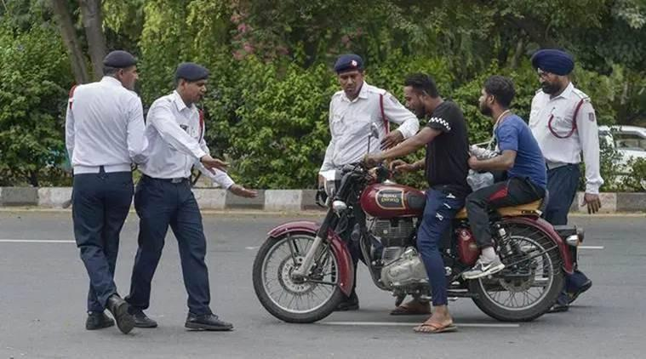
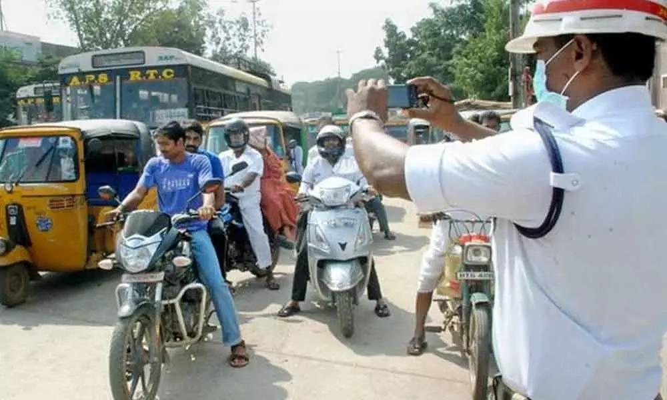
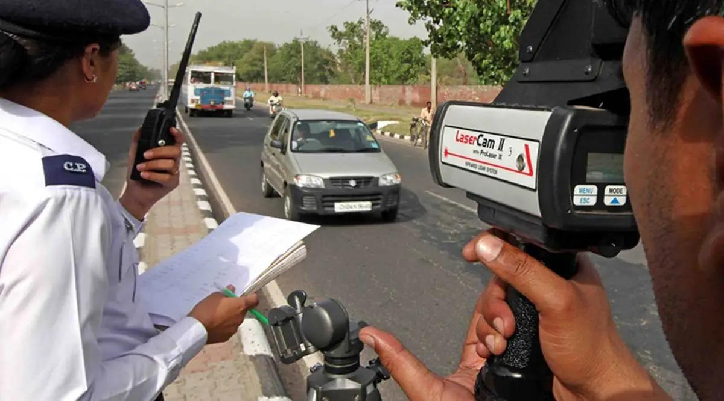
Workforce spent in enforcing traffic rules and current challan system:

Slide 7

Improvements Possible in current Work System
Challan facility can be digitised and automated.
Work of traffic policemen can be semi-automated and some special arrangement can be made which can reduce their exposure to weather conditions and pollution.
Traffic Management can be improved and optimised as per traffic density.
When required, Special Traffic Arrangements can be made for smooth movement of VIP and emergency Vehicles.

Slide 8
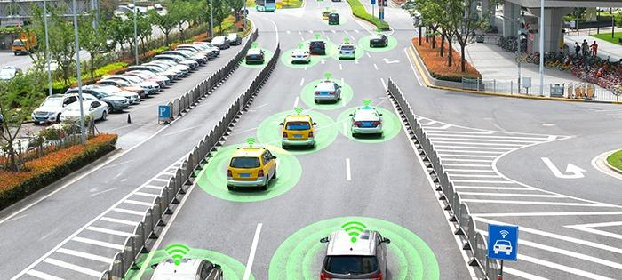
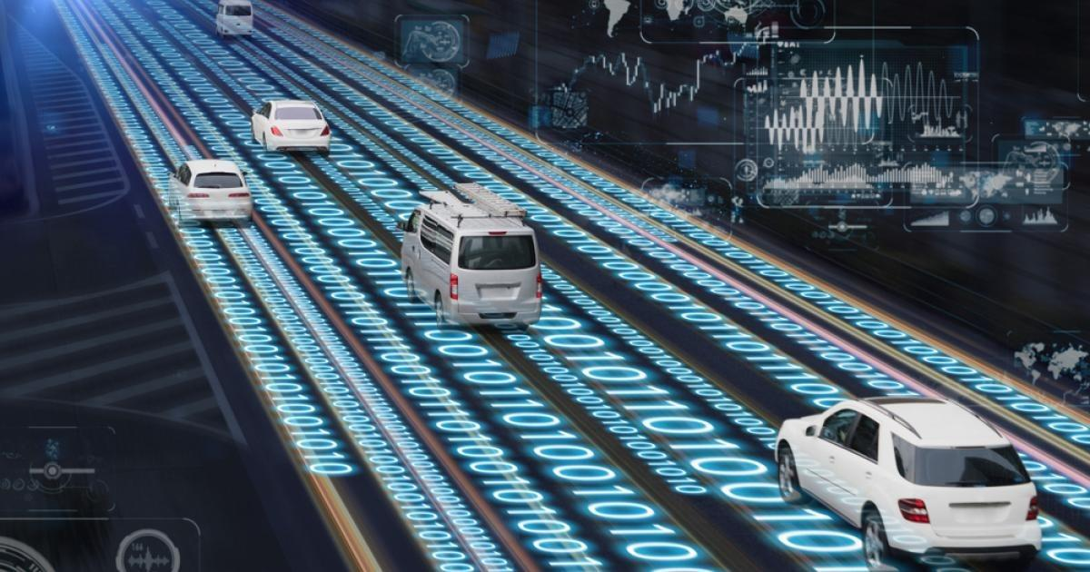

Slide 9
Our Strategies to provide an integrated system that can tackle all these
Set up of Traffic Police control Room (In accordance with Ergonomic Principles).
Use of Metallic hands, with integrated, synchronized and optimised systems work to handle heavy traffic.
High performance affordable cameras, to detect driver faces and vehicle number plates of rule breakers.
Automatic Challan system integrated with an email system that generates bills and re-directs it to the owner of the vehicle.
Facilitating Communication among Control Rooms to allow quick and faster implementations of internal plans.

Slide 10


That’s the transition we want to bring!!

Slide 11


